Slide 1
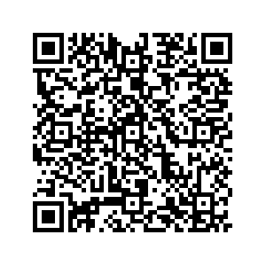
Anthroposophic Medical Grand Rounds Research Updates for Core Therapeutic Topics: English-language, Online, Worldwide
Wednesday, 16. October 2024: “Understanding Potentization and Enlivened Substance” With special presentations by Stefan Baumgartner, Harald Hamre and Ursula Flatters
1600-1800 CET (Dornach) 2100-2300 ICT (Bangkok) 1930-2130 IST (Delhi) 1700-1900 MSK (St Petersburg) 1300-1500 GMT(London) 1100-1300 BRT (Sao Paulo) 1000-1200 EDT (New York) 0700-0900 PDT (San Francisco)
“How AM Contributes to the Field of Integrative Oncology”
19. February 2025: With Eran ben Ari, Marion Debus, Friedemann Schad
“The Role of Warmth and Thermoregulation for Somatic and Mental Healthcare”
21. May 2025: Highlights from AM Research Council Conference

